Slide 1
CSE 331 Lecture Zero
Coding Pearls

Slide 2

L T P
Lecture - 2
Tutorial - 0
Practicals - 1
Credits – 3

Slide 3
Books
Reference Book
Cracking the Coding Interview by Gayle Laakmann Mcdowell, Careercup

Slide 4
COURSE CONTENT
Heaps (Priority Queues)
Disjoint Set Union
Binary Trees
Problems Based on Binary Trees
Graph Algorithms
Problems and algorithms based on Graphs

Slide 5
Syllabus
Unit-I: Heaps( Priority Queues)
Max Heap, Min Heap
Heap Sort
K’th Largest element in array
Sort an almost sorted array
Connect n ropes with minimum cost
Array representation of binary heap
Unit-II: Disjoint Set Union
Union-Find algorithm
Union by Rank and Path Compression

Slide 6
Syllabus (contd.)
Unit-III: Binary Trees
Types of Binary Tree
Insertion in a tree, Deletion in a tree
Tree traversals, Inorder, Preorder, Postorder
Inorder traversal without recursion
Print Postorder traversal from given Inorder and Preorder traversals
Level Order Tree Traversal

Slide 7
Syllabus (contd.)
Unit-IV: Problems Based on Binary Trees
Populate Inorder Successor for all nodes
Find N-th node of inorder traversal
Level Order traversal in spiral form
Boundary traversal of binary tree
Finding Lowest Common Ancestors
Sum of nodes in a binary tree having only the left child nodes
Diameter of a tree
Determine if Binary Tree is height balanced
Convert Binary Search Tree to Min Heap

Slide 8
Syllabus (contd.)
Unit-V: Graph Algorithms
Graph and its representations
Breadth First Traversal for a Graph
Depth First Traversal for a Graph
Eulerian path and circuit
Eulerian path for an undirected graph
Eulerian circuit for an undirected graph
Hamiltonian path in an undirected graph

Slide 9
Syllabus (contd.)
Unit-VI: Problems and algorithms based on Graphs
Dijkstra’s shortest path algorithm
Bellman Ford algorithm
Minimum Spanning Tree algorithms namely Prim’s algorithm, Kruskal algorithm
Graph colouring problem, Check if graph is bipartite
Detect cycle in graph, Check if cycle exists between two nodes
Strongly Connected Components, Shortest path from 1 to n
Minimum product spanning tree
Distance of nearest cell having 1
Count number of trees in a forest
Snake and Ladder Problem

Slide 10

COURSE EVALUATIONS
Compulsory
CA
ETP
Marks – 45
Marks – 50

Slide 11
Weightage Division
Attendance - 5 marks
CA - 45 marks
ETP - 50 marks
# All assessment tests would be conducted on third party platform.
# No Mid-Term Exam

Slide 12
Scheme for CA
Component | Weightage (%) | Mode | Timeline
Test- Situation based problem solving 1 | 50 | Online | 5th to 6th Week
Test- Situation based problem solving 2 | 50 | Online | 11th to 12th Week

Slide 13
COURSE OUTCOMES
CO1 :: relate the theoretical as well as practical knowledge to form an amalgamation of working code
CO2 :: employ a working combination of solution to ubiquitous problems which are time and space efficient
CO3 :: identify and comprehend the inner workings behind the design of an optimal solution
CO4 :: illustrate the usage of algorithms and data structures in the design of an optimal solution towards a problem
CO5 :: apply the knowledge gained from various algorithmic paradigms to design and develop optimal solutions for real-world problems
CO6 :: examine and utilise knowledge to build and design reliable code which is capable of passing various test cases

Slide 14
PROGRAM OUTCOMES
PO-1 Engineering knowledge::Apply the knowledge of mathematics, science, engineering fundamentals, and an engineering specialization to the solution of complex engineering problems.
PO-2 Problem analysis::Identify, formulate, research literature, and analyze complex engineering problems reaching substantiated conclusions using first principles of mathematics, natural sciences, and engineering sciences.
PO-3 Design/development of solutions::Design solutions for complex engineering problems and design system components or processes that meet the specified needs with appropriate consideration for the public health and safety, and the cultural, societal, and environmental considerations.
PO-6 The engineer and society::Apply reasoning informed by the contextual knowledge to assess societal, health, safety, legal and cultural issues and the consequent responsibilities relevant to the professional engineering practice.
PO-12 Life-long learning::Recognize the need for, and have the preparation and ability to engage in independent and life-long learning in the broadest context of technological change.
PO-13 Competitive Skills::Ability to compete in national and international technical events and building the competitive spirit

Slide 15
PROGRAM SPECIFIC OUTCOMES
PSO1: Apply basic knowledge in areas such as Software Engineering, Networking and Security, Database Management Systems, Intelligent Systems, Operating Systems, and System Architecture for building Software products.
PSO2: Provide effective and efficient real-time solutions using attained knowledge in interdisciplinary domains for societal benefits through projects.

Slide 16
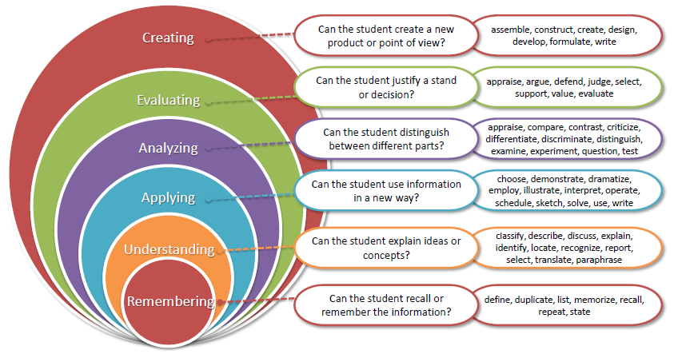
Bloom’s taxonomy

Slide 17
Star Course
A star course is a course, which plays a major role in any of the career pathway.
Career pathways are like Government jobs, Research field, Service based or Product based companies etc.
If you want to opt for any specific career pathway, then star courses related to that career pathway helps to achieve your goal.

Slide 18
Why Star Course?
This course is related to product based career pathway.
The course is designed to cover the problems and topics needed to crack coding or interview rounds in product based companies.
It helps to increase one’s problem solving skills and capabilities

Slide 19
Innovative Pedagogies
The LeetCode platform is used in the classroom for solving programming queries.
Geeks for Geeks unsolved problems and solved Questions are discussed.
Hacker Rank platform is used for conducting the CAs

Slide 20
EDU-Revolution Categories
Revenue Generation
Social Media Presence
Project
Recognition of Prior Learning
NPTEL/MOOC
Grade Upgradation (Core/Non-Core)
Internship Beyond the Curriculum
Community Service
Co-curricular/Extra curricular activities
10% Attendance Benefit
Duty Leave
Earn Extra Credit

Slide 21

Edu-Revolution
Consider applying on UMS > LMS > Edu-Revolution benefits
OR in LPU touch
RPL- Recognised prior learning
Gain benefits on the basis of previously learnt subject and get exempted on current subject.
Before the start of each term, students who believe they already possess the required knowledge or skills in a course registered to him/her in upcoming term, can request a relaxation from the course and attendance via an online interface.
21
www.lpu.in Lovely Professional University

Slide 22
How RPL is Applicable
Under the EduRev RPL Framework, the following process is followed:
1. Eligibility for RPL
Learners who believe they already possess the skills and understanding covered in the Coding pearls course may apply for RPL.
2. Assessment Process
Once the RPL application is accepted, the student will be required to appear for an RPL assessment/examination.
This exam is designed to evaluate the learner’s knowledge in Coding Pearls.

Slide 23
3. Performance-Based Exemption
If the student achieves marks above the defined threshold set by EduRev, they will be considered to have met the learning outcomes of the course.
In such cases, the course requirement will be exempted, and the student may proceed to other subjects or stages of their academic program without taking the full course again.
4. Certification and Records
Upon successful RPL approval, the exemption is recorded officially, and the learner’s academic transcript or learning portfolio will reflect the credited course based on RPL.

Slide 24
Benefits for Students of EDUREV
Saves Time: No need to re-learn content already mastered.
Cost-Effective: Avoids paying for and attending a course unnecessarily.
Recognizes Experience: Validates prior work or independent learning in AI.
Supports Lifelong Learning: Encourages learners from diverse backgrounds to participate in formal education.

Slide 25
List of MOOCs Or Industry Certifications
Sr. No. | Course Name | Platform | Duration
1 | Getting Started with Competitive Programming | Swayam | 12 Weeks
2 | CodeChef Certification in Data Structure & Algorithms | CodeChef | Proctored based Exam

Slide 26
References & Research Resources
a) https://www.hackerrank.com/domains/data-structures
b)https://www.codechef.com/selflearning?itm_medium=navmenu&itm_campaign=learncp
c) https://leetcode.com/explore/
d) https://www.spoj.com/problems/classical/

Slide 27

Zero Lecture - Feedback
OR
Use short link: https://l1nq.com/EiZz5
Thank you!!

